Slide 1
MultiPlex: What is it to System Design
Dr. Michael Anderson PhD
Dr. Jay Thiagarajah PhD MD
Boston Children’s Hospital

Slide 2
Workshop Outline
Multiplexing in general
Design of Spectre-Plex system
Image capture
Pre-processing of images
Example images
Data Analysis, Visualization, and Example Study (Jay)

Slide 3
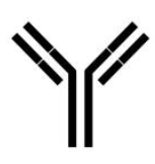
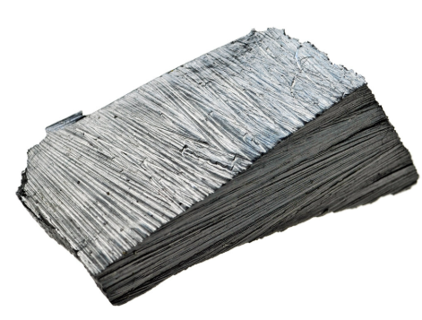
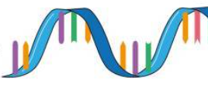
What is Multiplexing?
Observing high number of markers on a sample, typically greater than 5 markers
Target Binder
Linker
Reporter
Protein
RNA
Metal Lanthanide
Fluorophore
NHS-ester, DNA barcode, 2nd Antibody, Dextran, Proprietary
Marker Construct
or
or
Multiplex Type | Number Cycles | Markers per Cycle
Color Compensation | NA | 7-8
Mass Spec | NA | 30
Cyclic Multiplexing | Virtually Unlimited | 5
Marker Limits

Slide 4
Mutli-Cyclic Multiplex Proteomics Landscape
Every technique is defined by what part of the marker complex is removed each cycle
Remove Antibody
Remove Linker
Remove Reporter
How | System/ Technique
High temp detergent | Lunaphore Comet
Linker Type | How | System/ Technique
DNA Barcode | Chaotropic Solvent | Akoya Phenocycler (Codex)
UV Cleavable Linker | UV Laser | NanoPlex
Dextran | Dextranase | Miltenyi MACSima
How | System/ Technique
Chemically Bleach | Leica Cell Dive/CyCIF/IBEX/SpectrePlex
Light Photobleach | Miltenyi MACSima

Slide 5
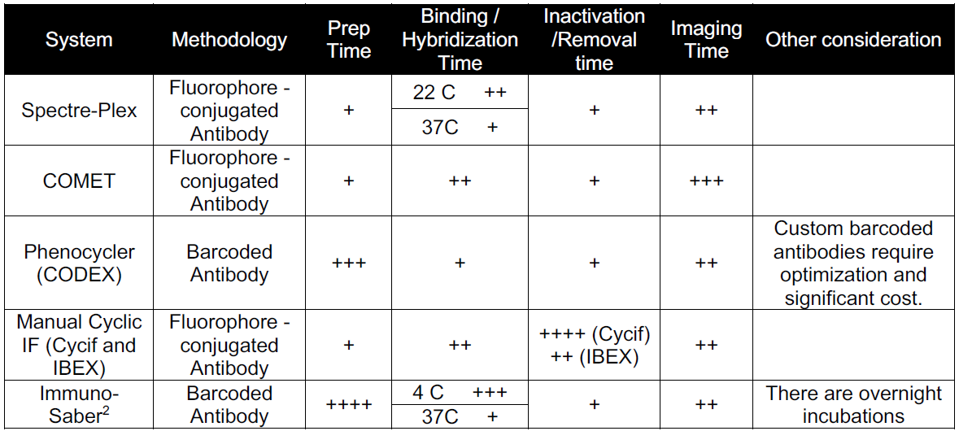
Technique/System Comparison

Slide 6
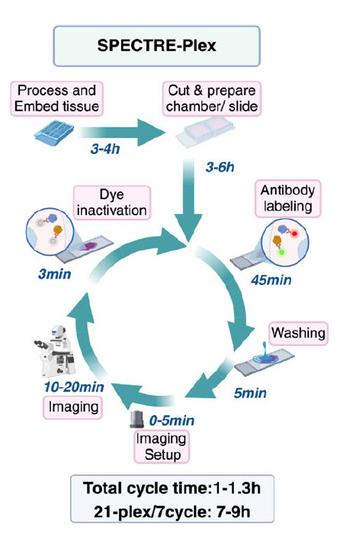
What is the Spectre-Plex?
SpectrePlex is an optimized automated system built around a modified technique for CyCIF and IBEX
Why choose bleach/restain? Its open source and uses cheap, off the shelf reagents
Major Design Issues/Solutions
Imaging same locations each cycle/Slide stationary onstage for all steps
Slides too thick for high resolution objectives/Image from top down (upright)
Need low volume automated fluid exchanges/microfluidic setup
Coverslips difficult to manipulate/water optics design

Slide 7
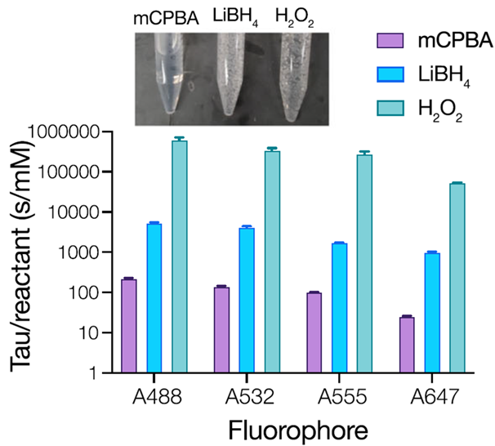
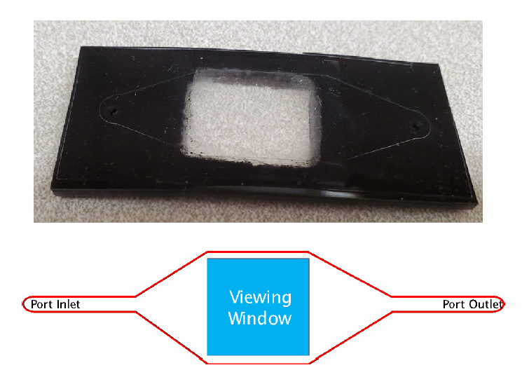
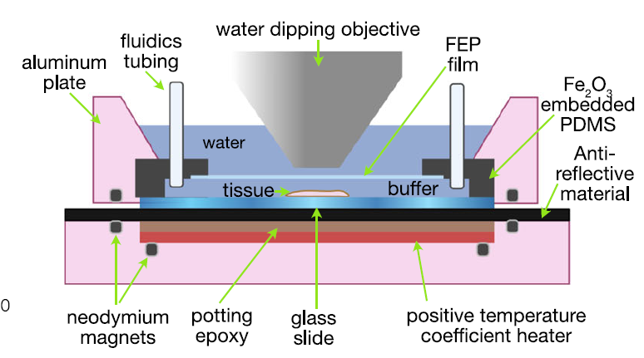
System Engineering Hurdles
Ultra Fast, Microfluidic Compatible Bleach Solution
Fluidic Device with Water RI Window (Invisi-Slip)

Slide 8
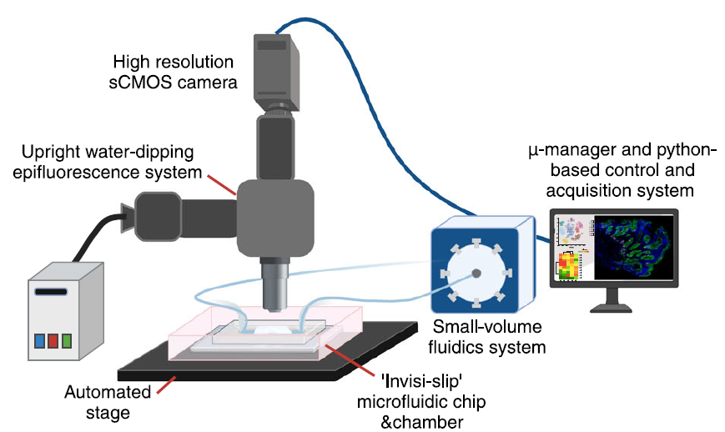
Pictorial System Overview

Slide 9
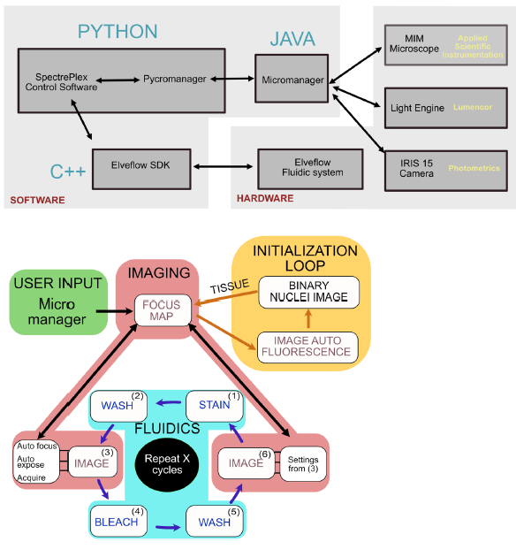
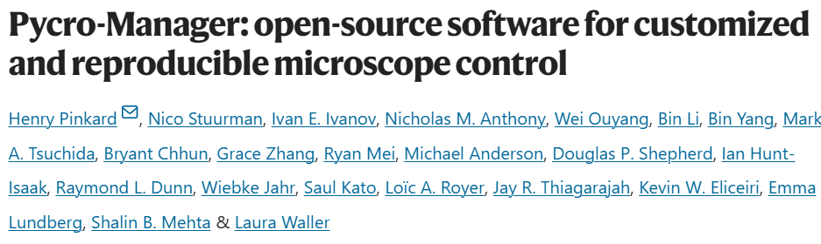
Microscope Control
Prior to Pycro-Managers creation, it was difficult to have scripted control of microscopes
Time saved by identifying tiles that contain tissue and not acquiring ones with no tissue
Autofocus and Autoexposure algorithms are very subjective
We employ a quick image contrast focus on DAPI at each tile right before each tile is acquired
Instead of honing in on a specific exposure time, we employ an HDR exposure style that exposes nearly every stain effectively

Slide 10
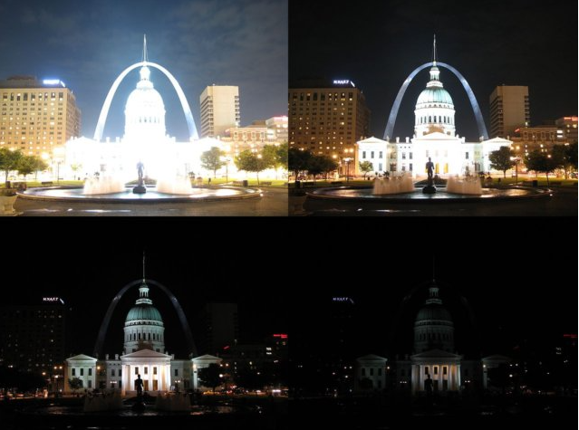
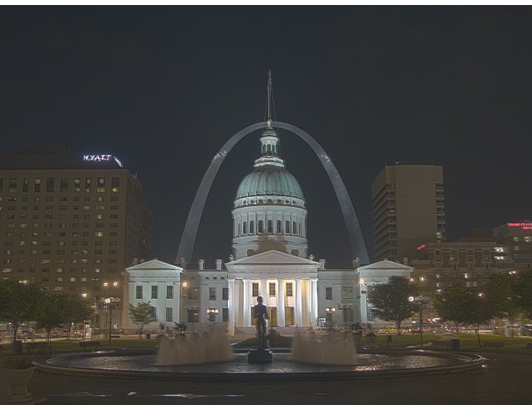
What is HDR?
Multi exposures
In traditional photography, several objects may exist in the foreground that are of interest. In this case, some may be brighter than others.
HDR in short is am attempt to increase dynamic range and help us visualize all objects of interest at one time.
Steps are usually:
Take multiple pictures with different exposure times
Align images
Convert from intensity to irradiance via CRF (camera response function)
Merge all images via weight function
Twist rendering parameters like gamma and RGB display ratios
This is highly effective in traditional photography as light in these conditions has very little associated error and we care more about visualizing and not quantifying, thus choosing a weight function that picks middling intensities makes everything roughly a similar intensity and thus can be visualized by a human at the same time looking roughly the same brightness.
Fluorescence has different constraints and goals. Especially in the context of the SpectrePlex.
SpectrePlex/Fluorescence Goals
Preserve relative intensity information
Poisson Noise limited, weigh towards bright pixels to minimize this
CRF is extremely linear, thus giving us the function apiori
All channels are gray scale (no RGB), can and should be freely manipulated independently for visualization.
No alignment needed
HDR Image

Slide 11
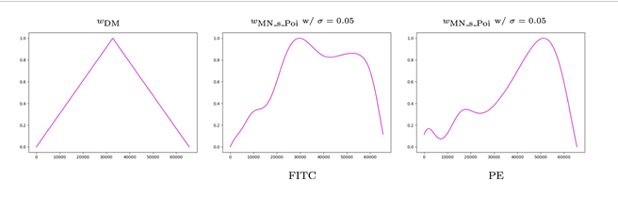
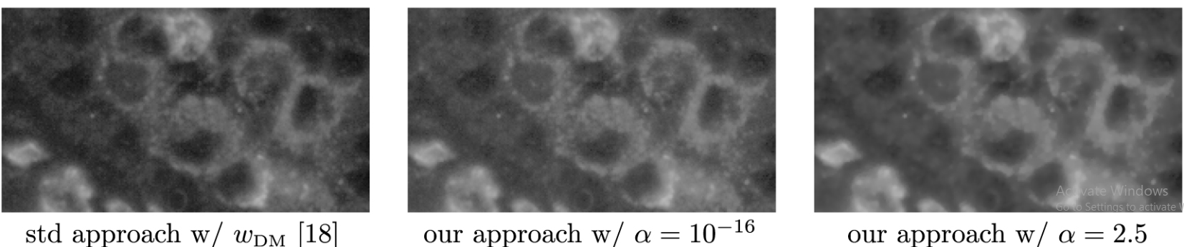
Miltenyi Biotech HDR Background
This is the first attempt to transform the HDR technique into fluorescence microscopy
TL:DR, it alters the weight function to favor higher pixel values by taking into account Poisson noise. Used stats to figure out deviations from poisson noise when making weight function. Everything else is the same.
Their approach allows objects to be properly exposed and displayed on the same image regardless of true intensity differences ala traditional HDR with no apriori knowledge of the stain.
Weaknesses
No way to verify relative intensity value accuracies and almost certainly has no negligable distortion of them
Generating image by image weight curves that can alter intensity ratios means bleached and stain must be subbed before applying algorithm. Thus cannot be run on the fly.
When compliance function is ramped up, produces artifacts in image. Some might say noise removal, but that is best left to programs like N2V as this looks artificial.

Slide 12
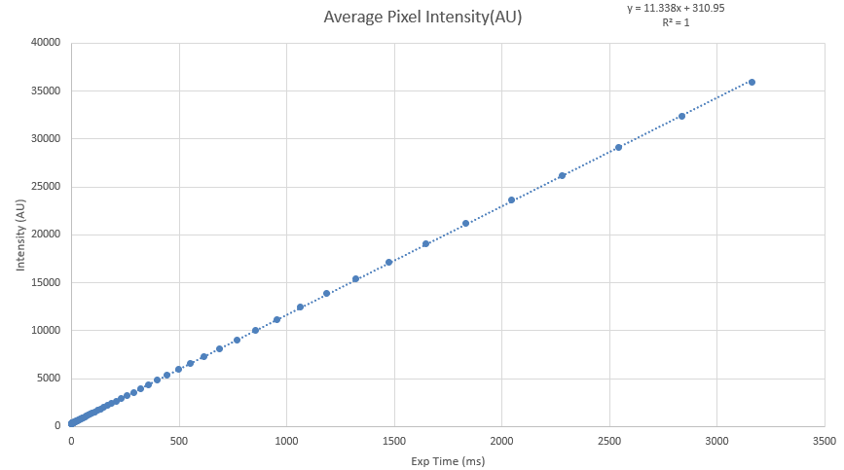
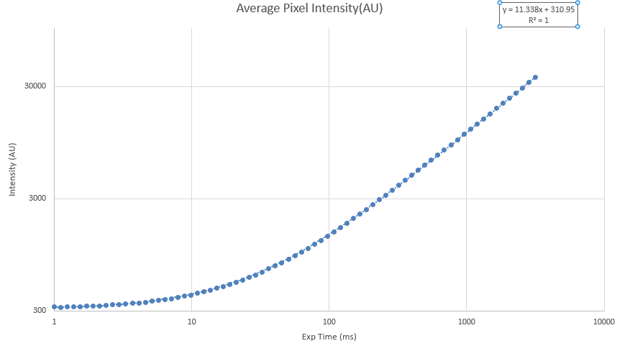
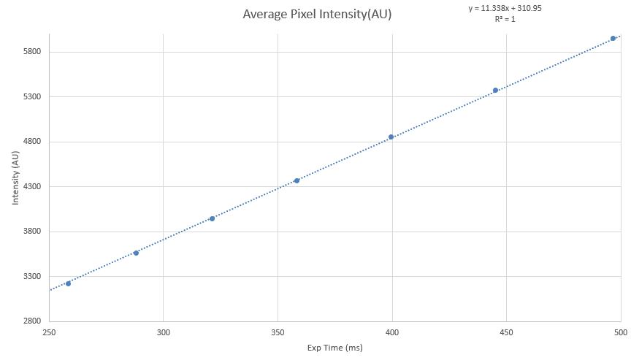
How linear is linear?
sCMOS cameras are reported to be extremely linear. If this is accurate, we know the CRF without ever needing to measure it in the image.
Below are three charts. They are all based off of images that were gathered in the exact same spot and just had different exposure times which are equal spaced in log space.
Linear linear scale
Log10 Log10 scale
Intersection zone
Log log scale is to exaggerate deviations and its clear that nothing big exists.
Intersection zone is zooming into an area that is around 4k intensity. This area is important as cameras are dual read by 12bit ADCs with different gains. They overlap around the 4k area and that overlap is used to match them ala stitching. This shows that extreme linearity still exists even at its weakest point.

Slide 13
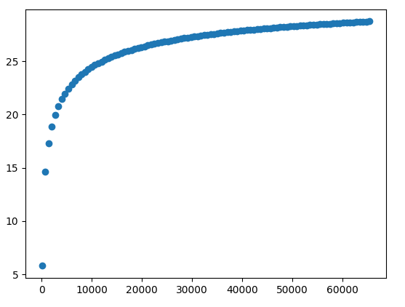
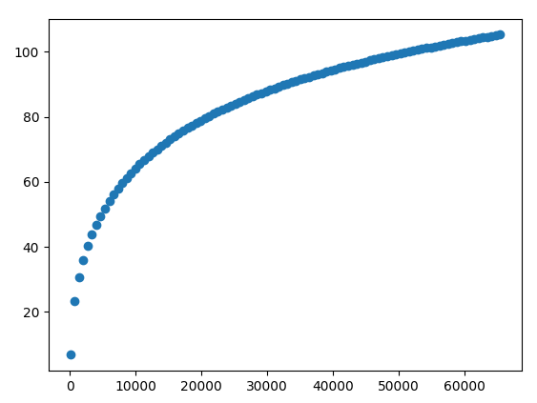
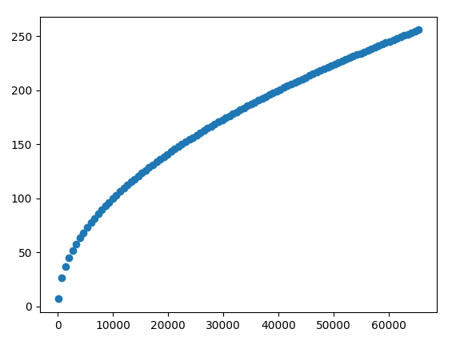
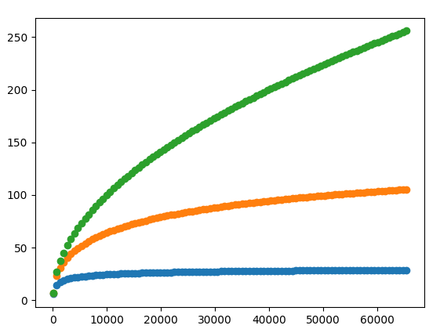
10ms
150ms
1000ms
1000ms
150ms
10ms

Slide 14
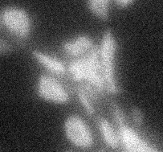
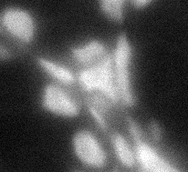
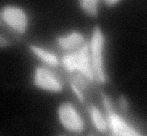
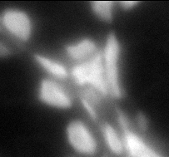
47ms
177ms
827ms
Fusion
Notice the image looks nearly identical to the 827ms image. That is as expected as it had by far the highest weight in the addition equation

Slide 15
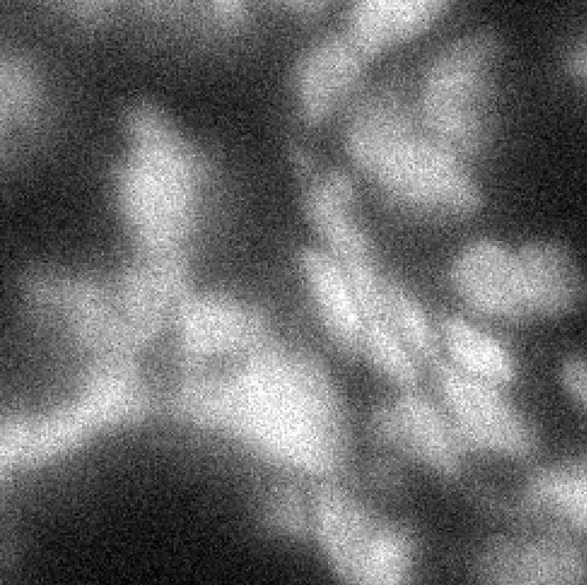
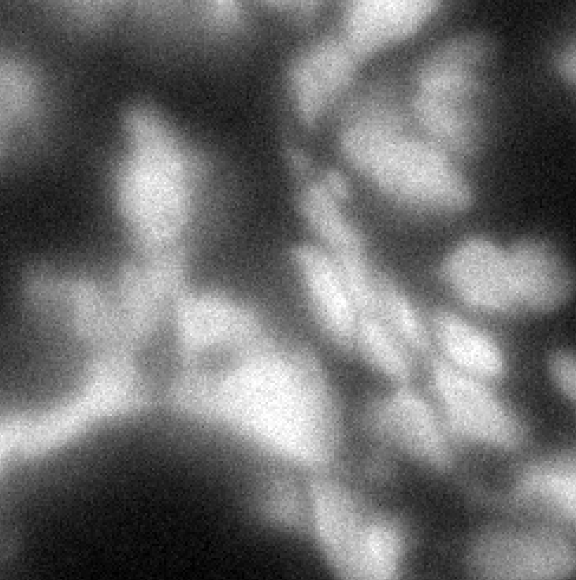
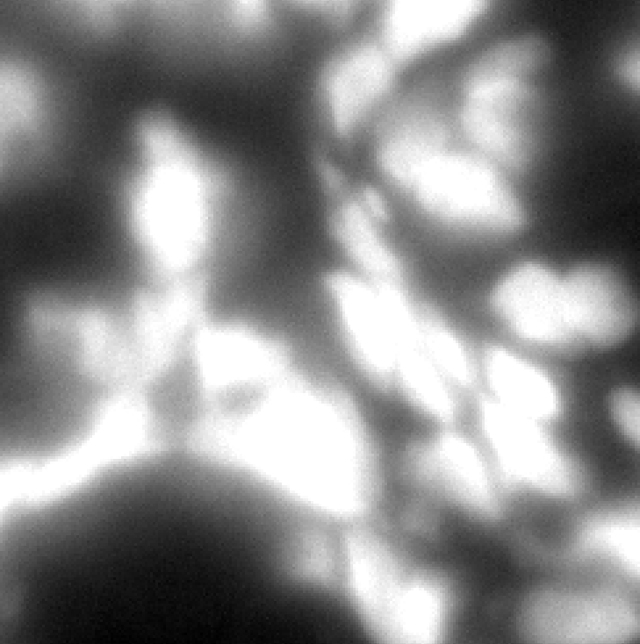

Saturated
Many regions where pixels are saturated in image

Slide 16
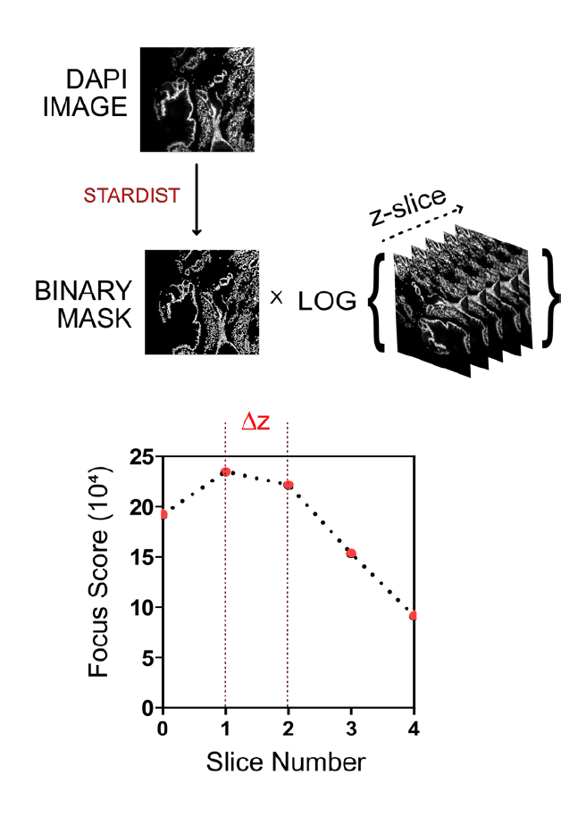
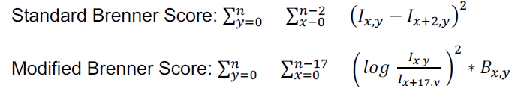
Auto Focus
Apply shift to Focus Map for all channels
Focus Score
$$B_{x,y}=0 if no nuclei present, =1 if nuceli present$$
Maximize score for DAPI image
Only Score where object of interest exist
Reduce weight due to brightness

Slide 17
Pre-Processing
Each step should address a correctable issue in the acquisition of the images
Our widefield system has unevenness in the excitation illumination field
We get a good amount of background from reflected photons, autofluorescence, etc.
HDR results in 32 bit images, but needs converted back down to 16 range for the stitching program to handle (McMicro)
TIF stacks needs created and OME metadata added into it in order for McMicro to be able to parse the images and align and stitch them together (Ashlar)
BaSiC
Dark Frame Subtraction
32bit-16bit compression
OME-TIF stack organized for McMicro

Slide 18
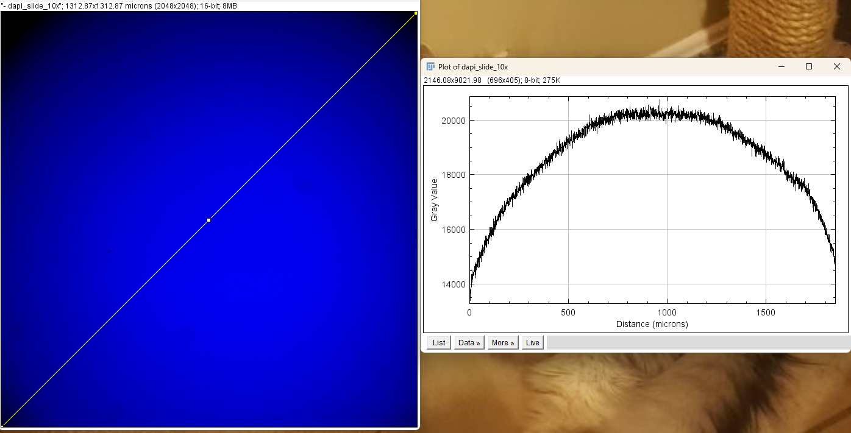
What is good enough flat field illumination?
Its hard to find standards for this thing. Iain from Lumencor said 20% roll off is acceptable, but didn’t seem confident in it.
Doubtful industry standard exists
Given standards don’t seem to exist, what does the illumination profile look like on a professionally installed and engineered microscope that has recently been installed, look like?
DAPI slide on Leica Thunder widefield system with lumencor light engine and 3mm LLG
Camera is 2048x2048 (6.5um pixels) and objective was 10x

Slide 19
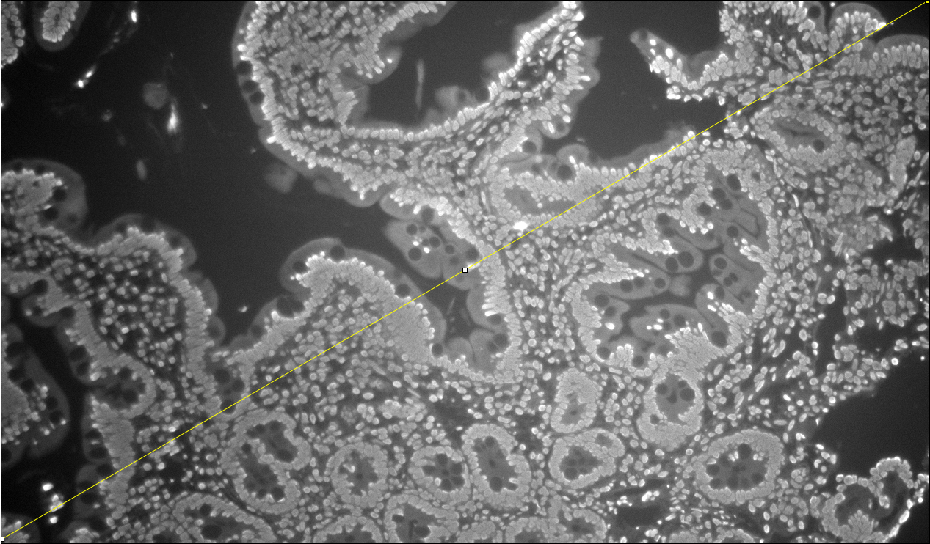
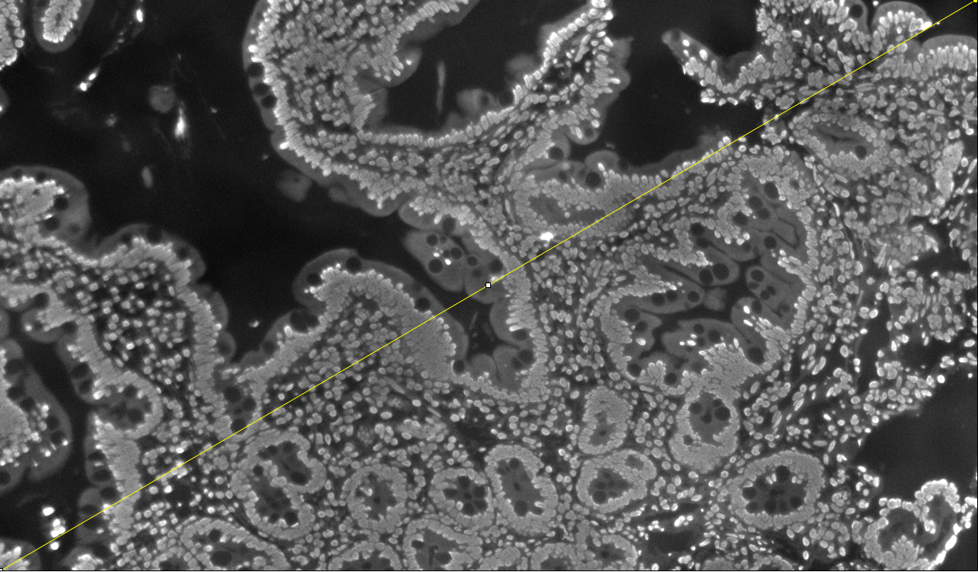
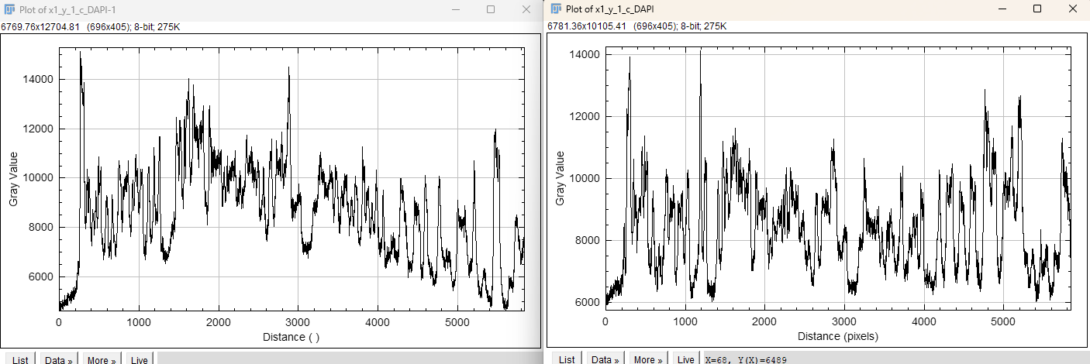
BaSiC Demo
Raw
Basic Estimator Applied

Slide 20
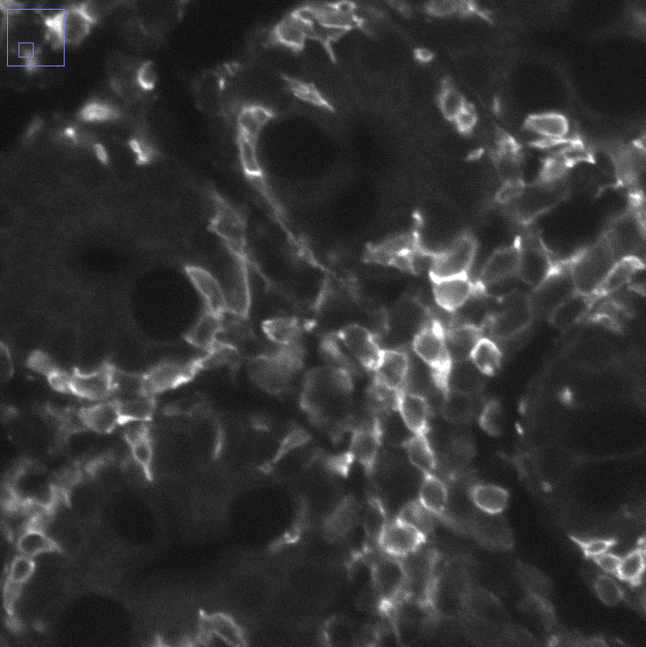
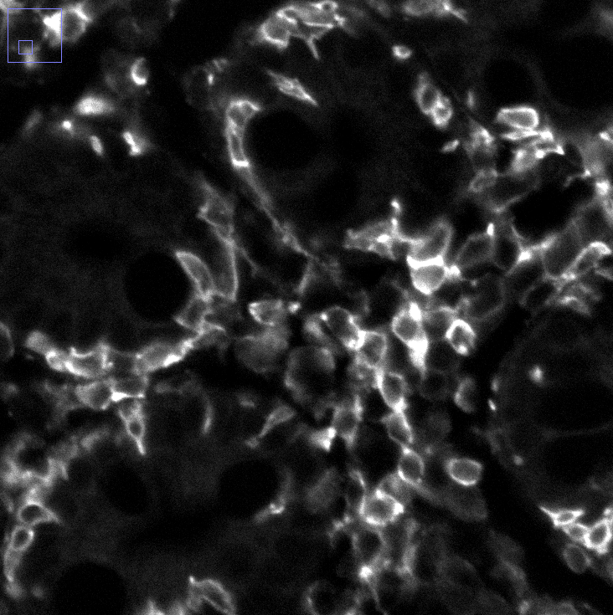
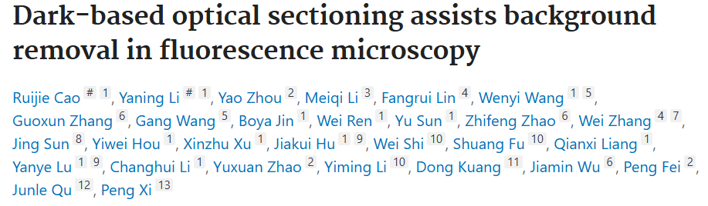
Dark Frame Background Subtraction
Before
New BckGnd Pixel = Min in window
Raw Im
Raw Im
Dark Frame BckGnd Im
BckGnd Subbed Im
-
=
After
Rolling ball artifacts much more sensitive to window size than Dark Frame
Dark Frame Inherently gives better SNR in images

Slide 21

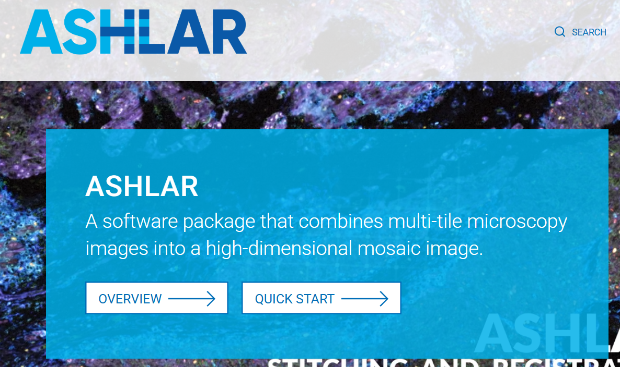
McMicro (Ashlar)
Creator Jeremy Muhlich (HMS)
Fully Open Source
Ashlar is unique software that registers all cycles and stitches at the same time
Mcmicro is a pipeline software that contains many modules of which Ashlar is one

Slide 22
Storage
Data Storage
5Tb Cluster Computer Storage
Run analysis program on images
Manually send final images to be analyzed
Analysis Computation
Unlimited G Drive
E3 Cluster Computer
Pro tip: unlimited means only space, not object count
Auto Upload Tar folder
And Stitched Final Images
Microscope Control, Preprocessing
Tar Archived Files
Local Workstation
Local NAS Server (20Tb)
Raw Im
Small Scale Testing
Run McMicro
McMicro Tif Stack

Slide 23
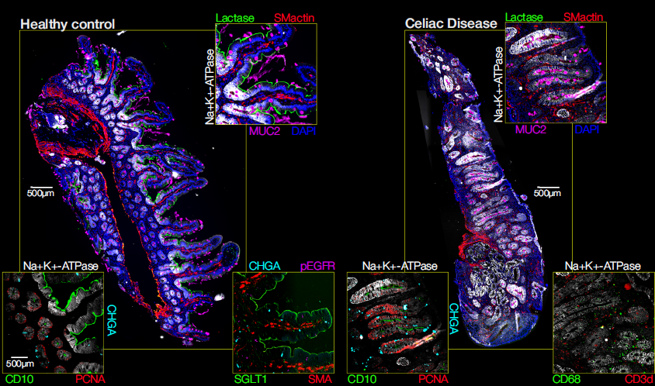

Slide 24
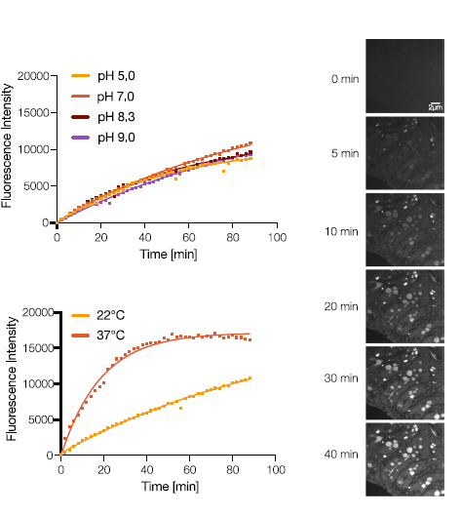
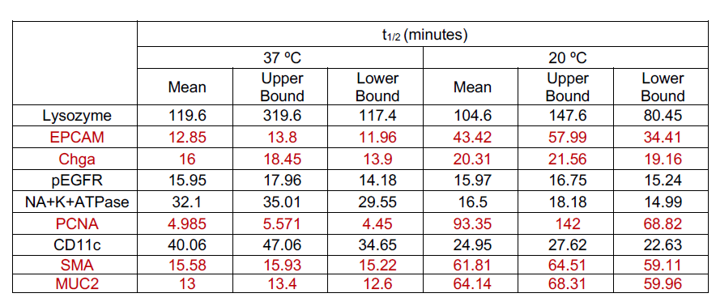
Kinetics
Due to the water optics and staining on stage, we had a unique setup in which the binding kinetics of directly conjugated antibodies could be observed
Able to determine binding half times and how temp and pH modulated them
With better temp control, possible to directly determine binding energies of antibodies

Slide 25
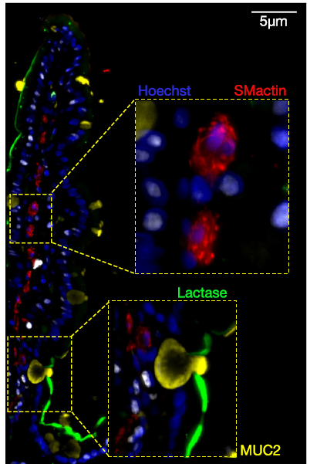
High Resolution
60x, 1.0NA
All current commercial systems use air optics and many even look through the slide glass (huge working distance needed)
Our unique setup directly allows for water optics and a viewing window not only is very close to the sample, but also introduces no aberrations in water
Opens the door for >1.0 NA objective use.

